Slide 1
PRESSMETAL-CZ, SPOL. S R.O.
Serial production of formed and welded parts

Slide 2
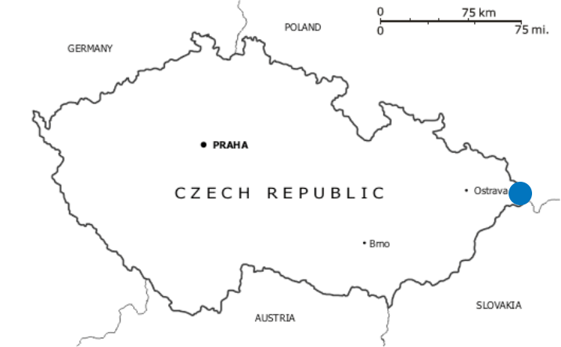
ABOUT PRESSMETAL
Established in 2002
Production hall is located in Trinec and Jablunkov
Strategical location near to Poland and Slovakia
Supplying to automotive, construction and engineering industry
Amount of emploees: 70

Slide 3
COMPANY SALES – TURNOVER (EUR)

Slide 4
APPEARANCE OF OUR PRODUCTS
Automotive industry:
BMW, Audi, VW (GER)
Ford (USA)
Škoda (CZE)
Toyota, Suzuki, Honda (JAP)
Hyundai, Kia (KOR)
Construction and Engeneering industry:
Optimont 2000 s.r.o.
Kovona a.s
Saviotechnics

Slide 5
QUALITY CERTIFICATION
External audits:
IATF 16949 standard– since 2018
ISO/TS 16949 standard from 2014 to 2017
EN ISO 9001 standard – from 2003 to 2014 Audit company - SGS Czech Republic since 2011
EN ISO 3834 standard – Welding quality management scheme – advanced welding quality requirements Audit company – Czech Welding Society since 2010
EN 1090-2+A1 standard – production of steel constructions Audit company - TZÚS Praha s.p. since 2012
Customer audits
Annually PressMetal-CZ undergoes product, process, internal, customer audits

Slide 6
QUALITY MANAGEMENT SYSTEM
PressMetal-CZ is proceeding in accordance with standards:
APQP – Advanced product quality planning
PPAP – Part approval process according AIAG
PPF – Part approval process according VDA
FMEA – Failure mod and effects analysis
Complaint procedure – 8D report
Statistical methods:
SPC – Statistical process control
R & R – Meassurement tools and equipment control

Slide 7
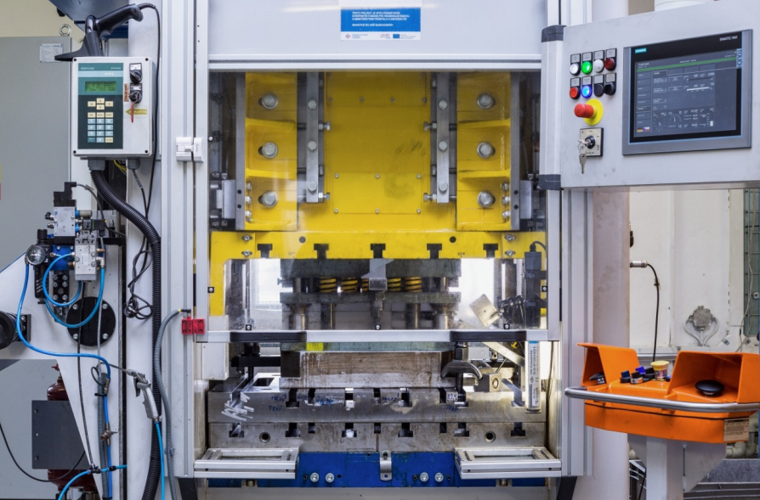
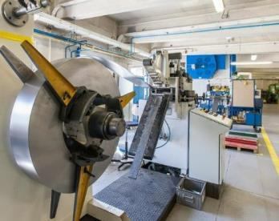
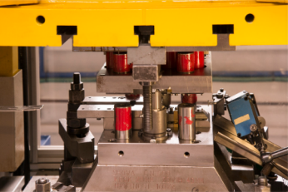
STAMPING
Produced by:
CNC press – 45t, 63 t, 100t, 200t & 250t
Eccentric press – 25t - 400 t
Availibilty from 15 press machines

Slide 8
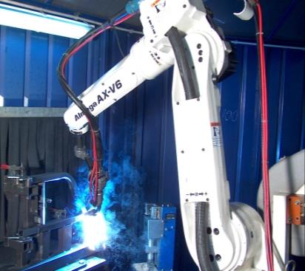
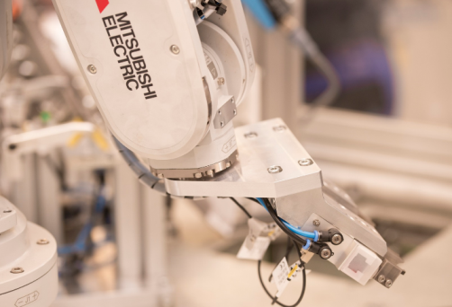
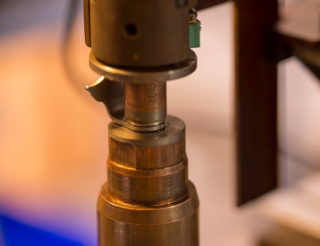
WELDING
Arc & Projection Welding
Manual and semi-manual welding
Robotic welding
Welding using MIG/MAG and TIG methods

Slide 9
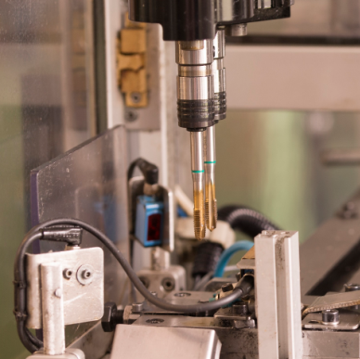
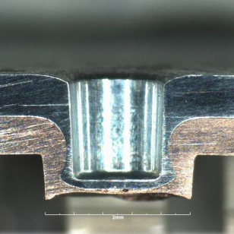
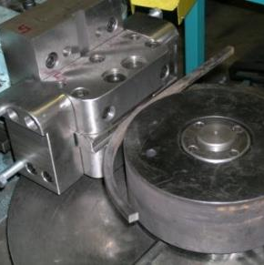
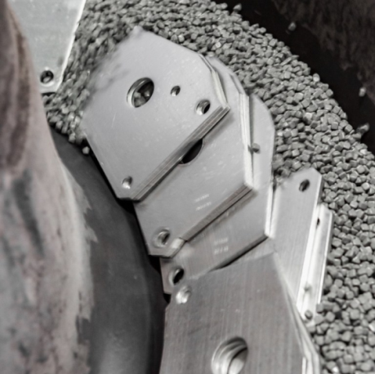
OTHER TECHNOLOGIES
Automatic threading
Clinching
Press-joining process
Bending
Bending materials with flat and filled profile up to radius 500mm
Tumbling
Recommended for small parts

Slide 10
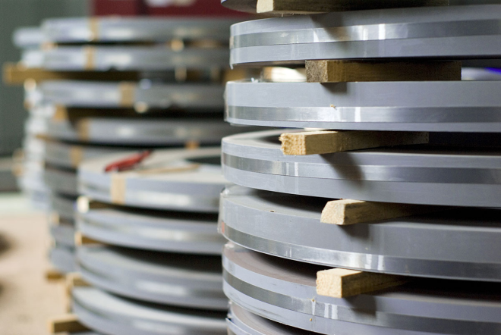
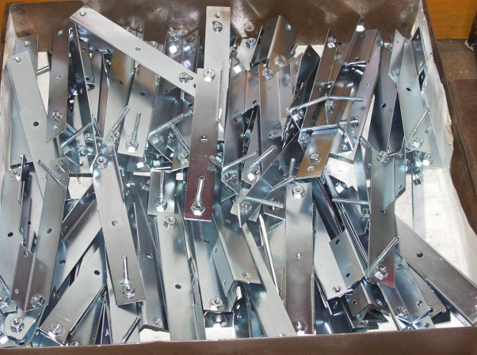
MATERIALS AND COOPERATION
Overview of used materials and surface treatments on current production
Used production materials
Steel
Stainless steel
Aluminium
Brass
Surface treatment
Galvanic Zinc coating
Hot Dip Galvanic Coating
Staining
Painting/ Powder Coating
Zinc - Nickel Phosphate Coating
Copper plating

Slide 11
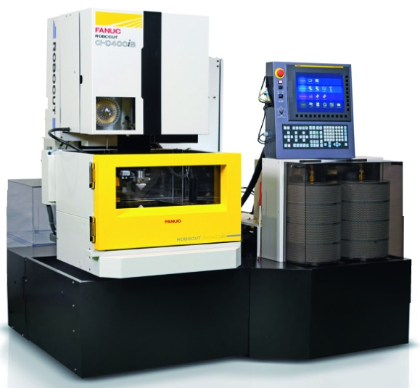
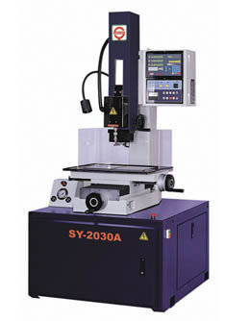
ELECTRICAL DISCHARGE MACHINING (EDM)
Wire EDM
EDM
EDM machines are used for shaping molds and producing complex shapes which are mostly used for stamping tools production.

Slide 12
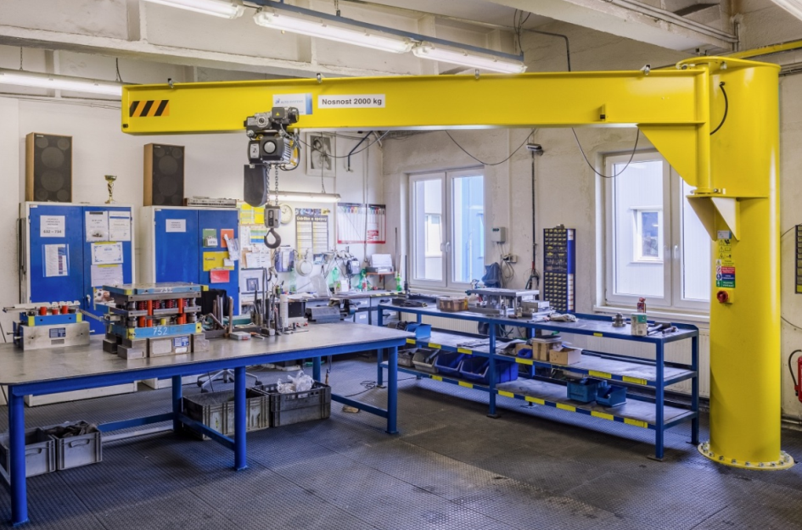
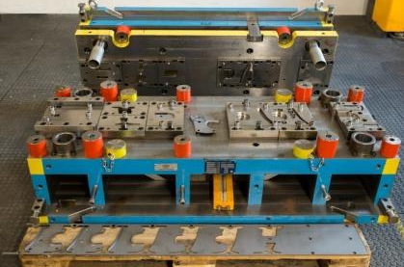
TOOLSHOP
Tools assemly
Tools maintenance
Tool production and assembly since 2017
Internal maintanance of tools
We offer simple repairs and regrinding of cutting tools

Slide 13
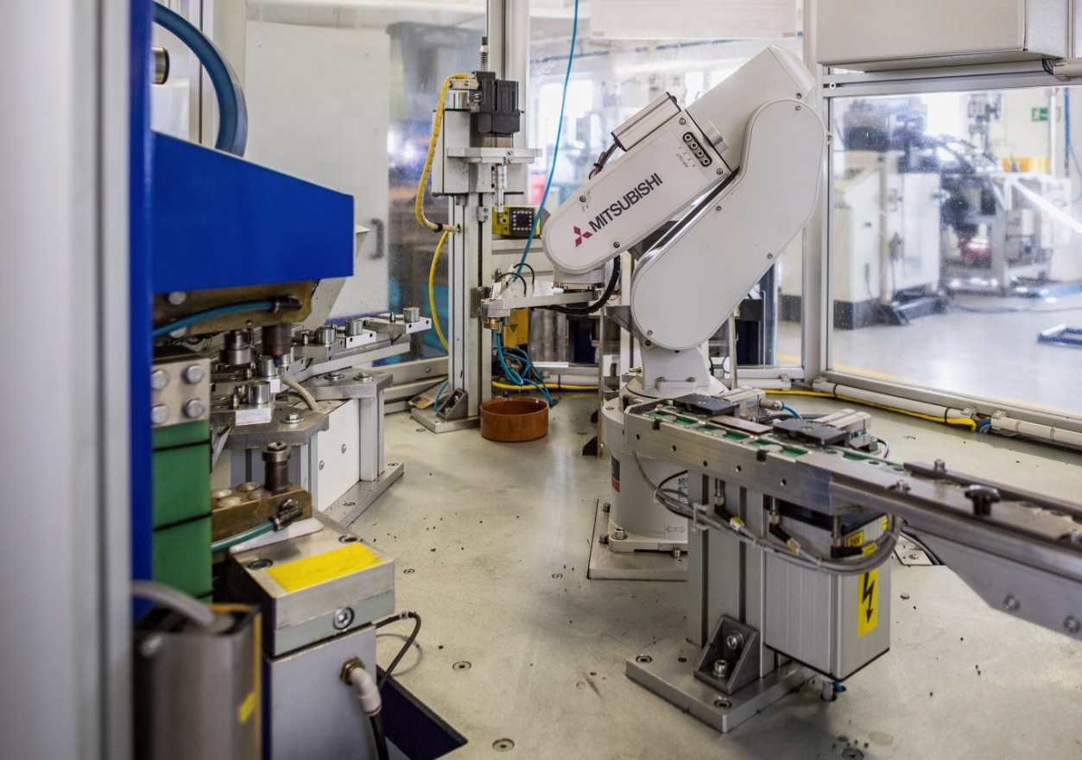
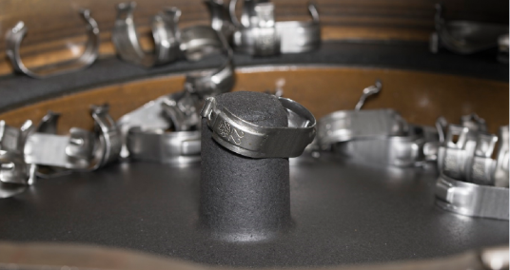
AUTOMATION
We provide for our customers automated production as well as automation of production line in cooperation with our partners

Slide 14
CONTACT
info@pressmetal.cz
+420 558 329 317
www.pressmetal.cz
Staré Město 138,739 61 Třinec

Slide 15
WE ARE LOOKING FORWARD TO FUTURE COOPERATION
FORMING A PART, SHAPING THE WORLD.

